Slide 1
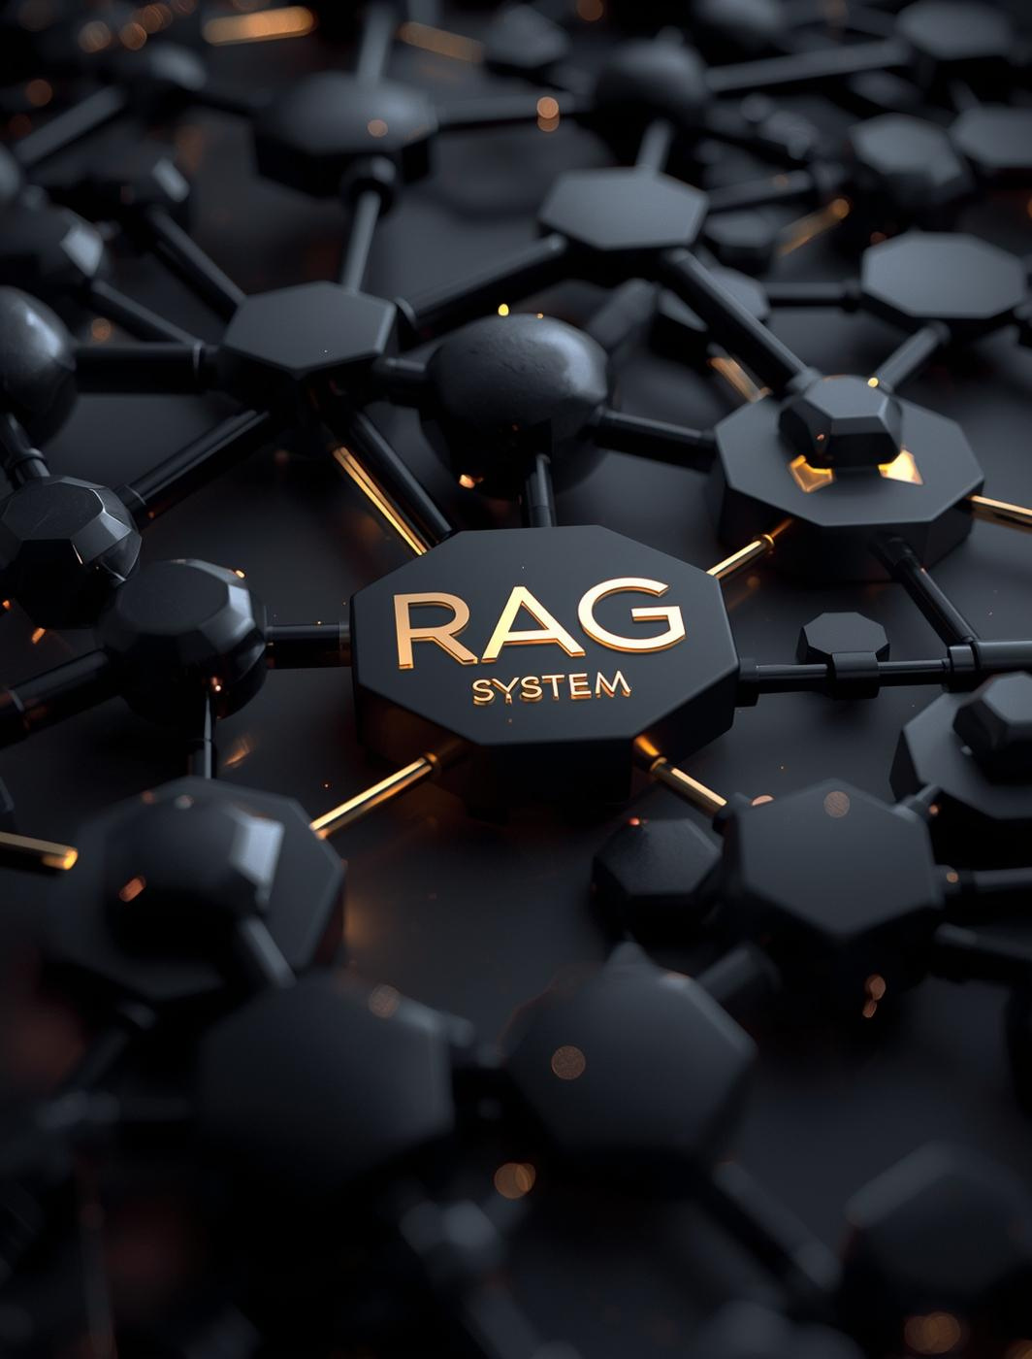
RAG System Development
Team Members:
Muralidhar Kolimali
Sunaina Makkena Spandana Dammanagari

Slide 2
Project Overview
Understanding the Importance of RAG in NLP Applications
The RAG (Retrieval-Augmented Generation) system serves as a bridge between vast data sources and precise information retrieval, enhancing Natural Language Processing (NLP) capabilities. This project highlights the real-world relevance of RAG by demonstrating its potential to provide targeted answers across diverse domains, ultimately improving user experiences and outcomes.

Slide 3

Project Requirements
The project requires the development of a RAG architecture, utilizing three open-source LLMs, formulating ten domain-specific questions, and conducting a comprehensive evaluation of the models. This structured approach ensures a thorough understanding of the retrieval-augmented generation process and its effectiveness in the selected domain, aligning with the course objectives.

Slide 4
Domain & Corpus
Overview of Data Sources and Their Significance in RAG Project
This project utilizes a meticulously curated corpus from various reputable academic and research databases. The preprocessing steps include data cleaning and normalization to ensure relevance and accuracy. This enhances the retrieval process, providing a solid foundation for the RAG architecture and enabling effective analysis of complex queries.

Slide 5
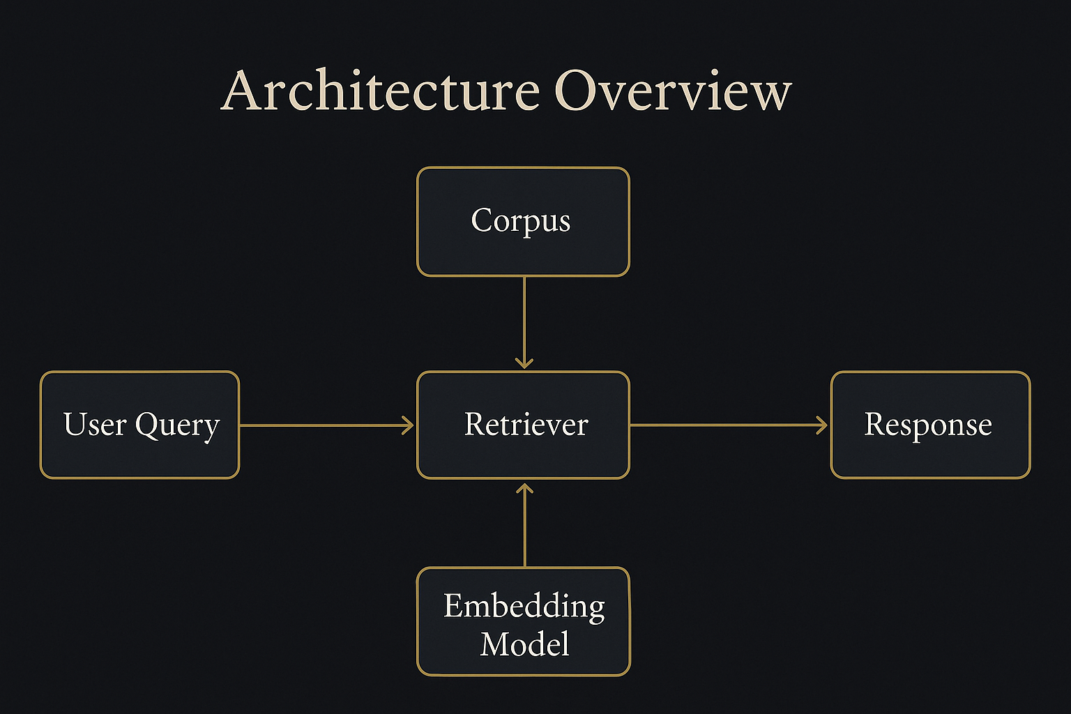
RAG System Architecture Overview

Slide 6




LLMs Selected for Comparison
Llama-3
Mistral-7B
Phi-3
Performance
High-performance open-source language model
Efficient and versatile architecture for tasks
Innovative model with robust capabilities
Strong metrics across various benchmarks

Slide 7


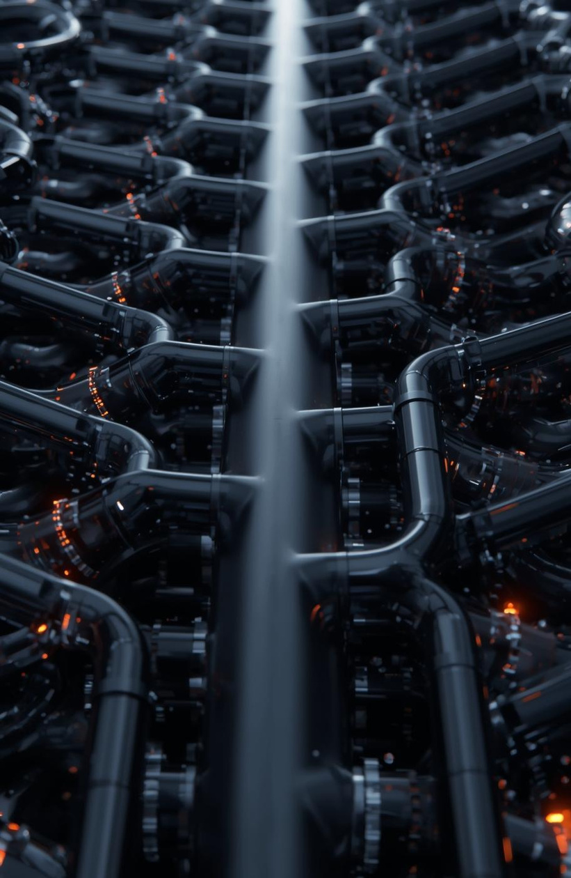

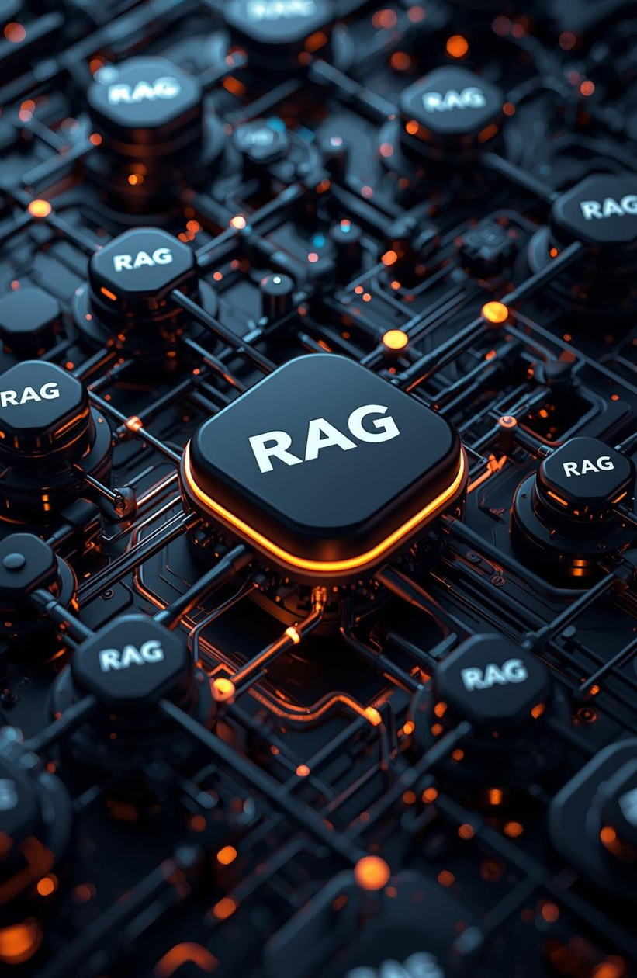
Embeddings
Retriever
Pipeline
Prompting
Implementation Overview
Visual representation of data transformations
Illustrating the process of information retrieval
Flow of data through structured pathways
Symbolizing user interaction and input
Visualizing the system's developmental aspects
System Implementation: Embeddings, Retriever, Pipeline, Prompting

Slide 8
Domain-Specific Questions
Curated questions for effective evaluation of LLM performance and reasoning
The selected questions cover a range of difficulty levels and topics, ensuring thorough assessment of the LLMs' capabilities. Each question is designed to test the model's reasoning skills and domain knowledge, providing insights into its practical applications and effectiveness in real-world scenarios.

Slide 9
Evaluation Methodology
Metrics for Assessing LLM Performance in RAG Systems
This section outlines the critical evaluation metrics used to assess the performance of the RAG system. We focus on accuracy, relevance, hallucination frequency, and reasoning capabilities. Understanding these metrics is essential for deriving insights and making informed decisions regarding model effectiveness in real-world applications.

Slide 10
85% Accuracy
Effective response quality
70% Relevance
Contextual information alignment
15% Hallucination Rate
Instances of false claims

Slide 11
Error & Hallucination Analysis
Visual insights into model inaccuracies and misinterpretations
This collection highlights common error patterns observed during evaluation, showcasing instances of hallucination, retrieval mistakes, and ambiguous outputs that impacted the overall effectiveness of the RAG system.

Slide 12
Insights & Discussion
Analyzing patterns, reasoning differences, and impacts of retrieval methods
This section delves into the key patterns observed across the evaluated LLMs, highlighting differences in reasoning capabilities and the implications of retrieval methodologies on performance. Understanding these nuances is essential for optimizing RAG systems and enhancing their effectiveness in real-world applications.

Slide 13
Limitations
Acknowledging constraints in RAG architecture and implementation
This project faced several significant limitations, including hardware constraints that affected processing capabilities, dataset limits that influenced the breadth of available information, and the quality of the retriever, which impacted retrieval accuracy. Addressing these issues is crucial for future enhancements and more robust system performance.

Slide 14
Future Directions
Enhancing RAG Framework: Embracing Hybrid Retrieval and Multilingual Capabilities
Future work will focus on implementing hybrid retrieval strategies that combine keyword and semantic search techniques. Additionally, we plan to explore reranking mechanisms to optimize response quality and introduce multilingual support to broaden accessibility and relevance in diverse linguistic contexts, ensuring a more inclusive RAG system.

Slide 15
Conclusion
A comprehensive evaluation of RAG architecture and model comparison
This project has achieved significant insights into the performance of various LLMs within the RAG framework. By evaluating strengths and weaknesses, we have established a clear understanding of how retrieval influences the quality of generated responses, laying the groundwork for future advancements in this domain.

Slide 16
References
Essential citations for RAG architecture and LLM comparison studies
This section lists the critical academic references that underpin the research and findings of the project. These resources provide valuable insights into RAG systems, language models, and the methodologies employed, ensuring a robust foundation for the study. Proper citations reflect academic integrity and contribute to scholarly dialogue.

